Slide 1
Survival Analysis-Cancer Prediction
Team Name::Code-Black
Team Members:: N.Supriya
T.Sanjanapriya
P.Yasmin
G.Madhumitha

Slide 2
ABSTRACT:
Introduction of Cancer prediction and necessity.
Machine learning and the model used for prediction.
Analysis of dataset and node red.
Finally conclusion.

Slide 3
Introduction:
What is cancer prediction?
Why it is necessary?

Slide 4
Applying Machine learning to cancer prediction.
Machine learning employs a wide variety of applications in medical field.
This capability is well suited in cancer prediction.

Slide 5
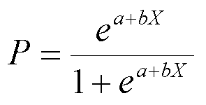
Logistic Regression
Logistic Regression is the classification model which is applicable to event existing such as pass/fail, alive/dead , etc.
Formula::

Slide 6
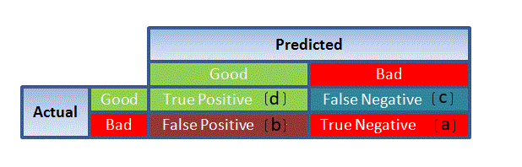
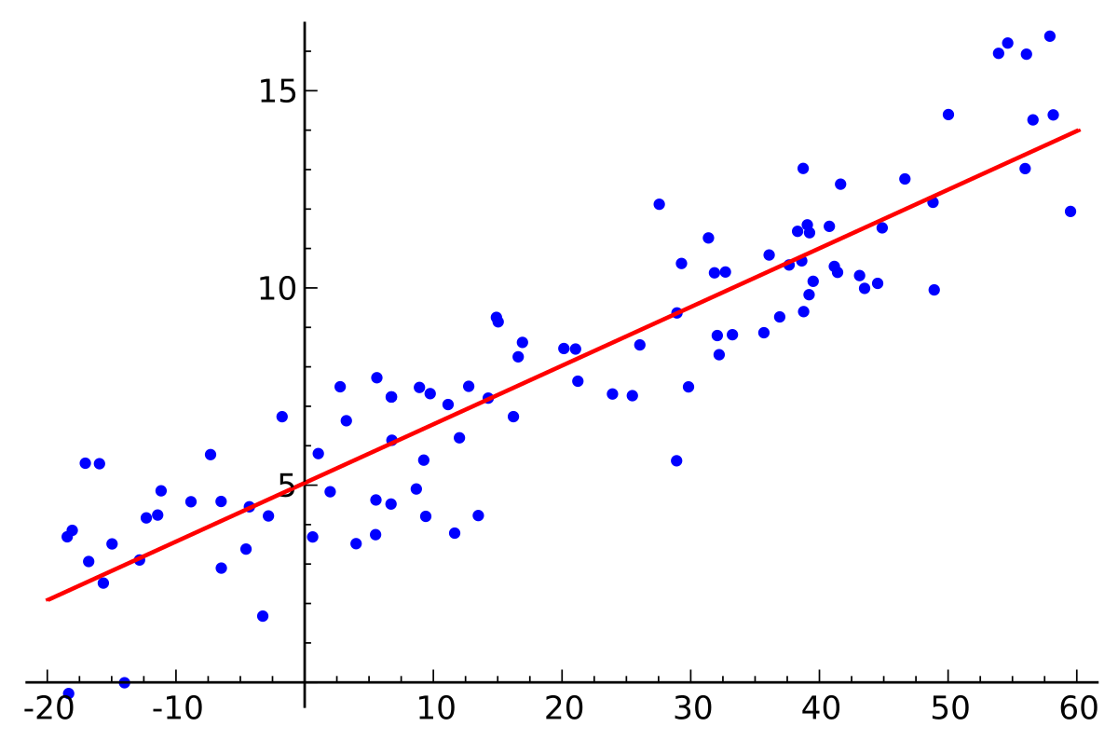
Figure :: confusion matrix and logistic regression

Slide 7
Dataset
Haberman’s data set contains data from the study conducted in University of Chicago’s Billings Hospital between year 1958 to 1970 for the patients who undergone surgery of lung cancer.
Link :https://www.kaggle.com/yusufdede/lung-cancer-dataset#lung_cancer_examples.csv
Attributes :
1.Name
2.Surname
3.Age
4.Smokes
5.AreaQ
6.Alcohol
7.Result(Survival Analysis )

Slide 8
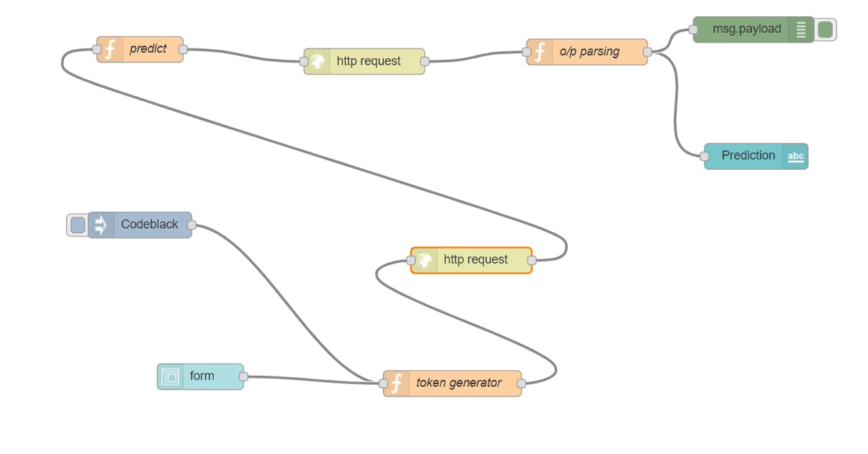
Node Red Flow::

Slide 9
Conclusion
We analysed several machine learning classification models to compare their results. The best model found is Logistic regression and reaches with an accuracy score of about 1.0

Slide 10
Thank You
Any Queries?

